Slide 1

The Remake of Brandie Android App
ANANT Pundir

Slide 2
Everything Comes Down to one single point: Business!

Slide 3
Sections
The Process
The UI / UX
The Backend

Slide 4
The Process
Selling Point of Company
Focused point of the app
Flow of UI
What hinders the UX? Temporary vs Permanent
Ease of Use
Reviews

Slide 5
The UI
Selling Point vs Focused Point
- Selling point: The brands, user generated contents, content sharing.
- Focused Point: JOIN THE GROUPS.

Slide 6
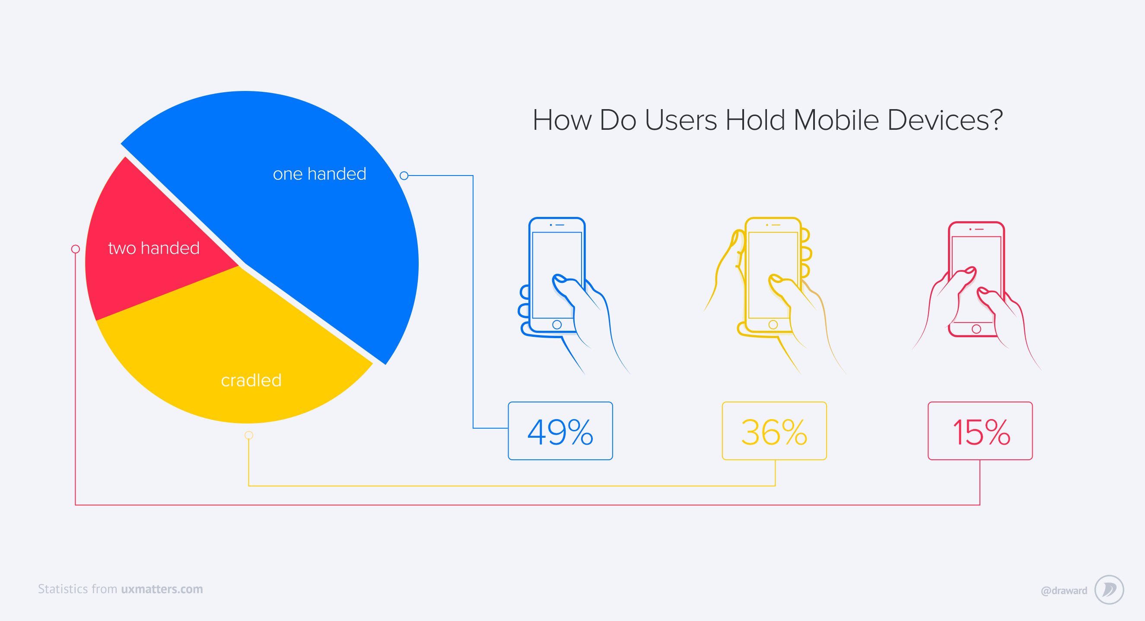
Thumb of Rule

Slide 7
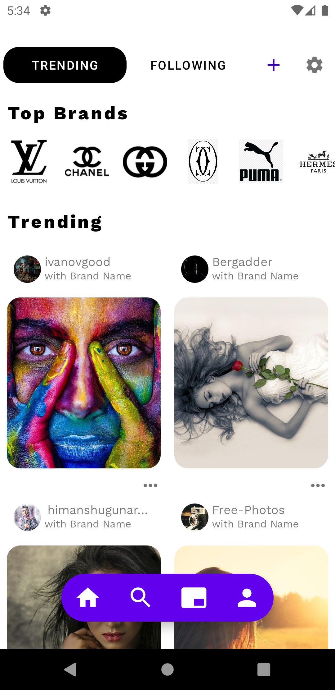
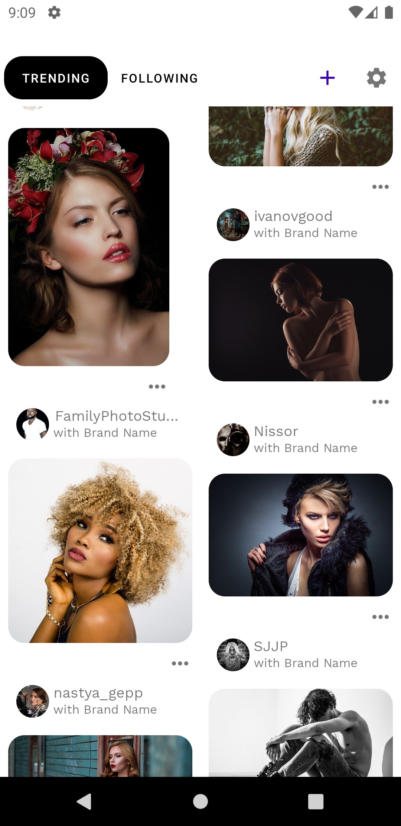
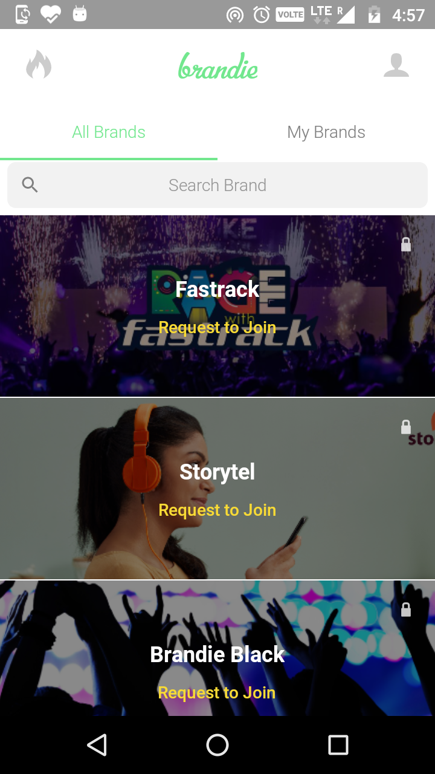
Selling vs Focused Point

Slide 8
The UI
New Home layout:
Represents the selling point
Familiarity.
Ease of use.
User centered.
Designed to make user spend more time. More time means more revenue.
Business Friendly; Promote brands.

Slide 9
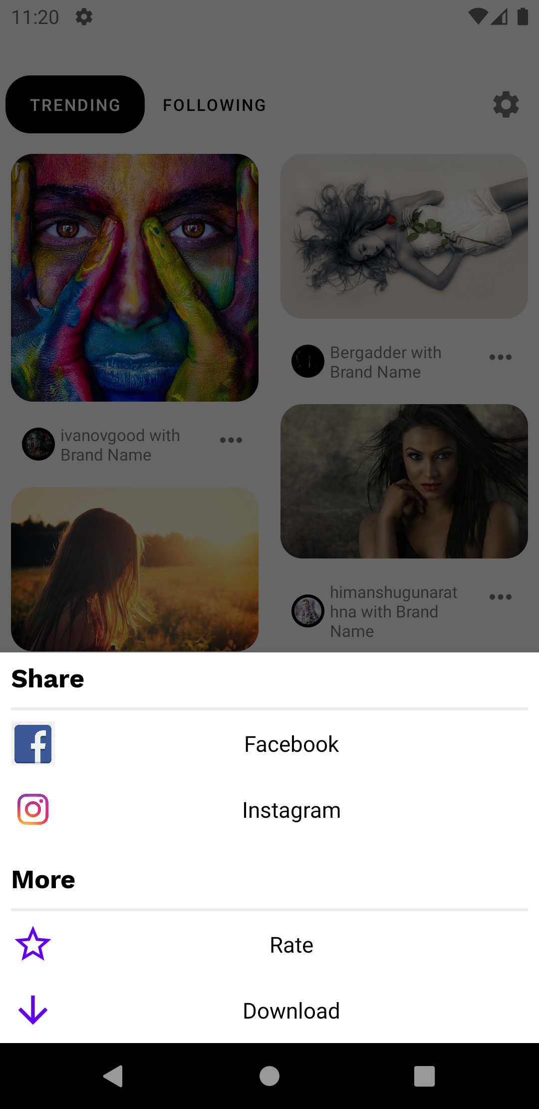
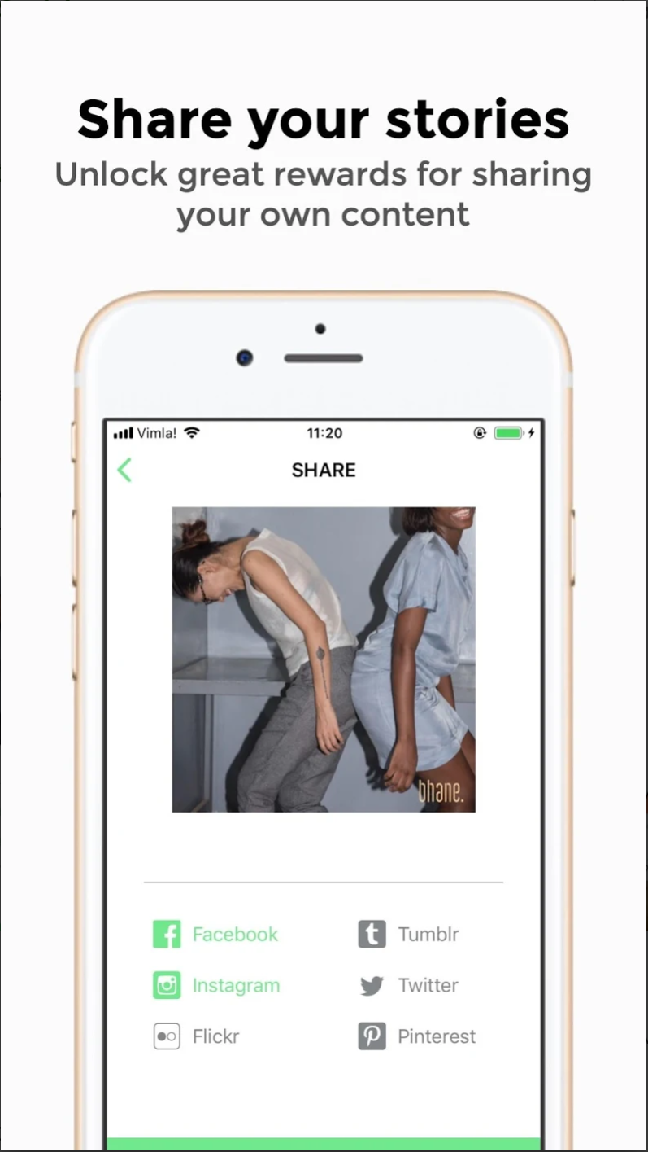
Sharing and more

Slide 10
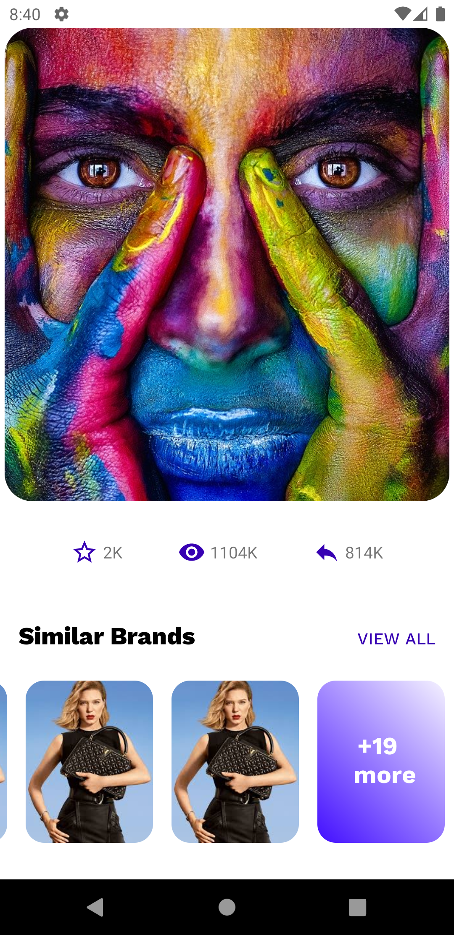
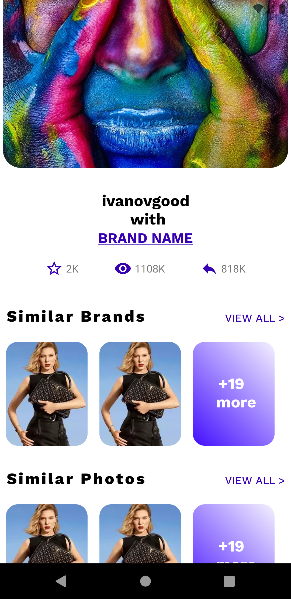
The Details, where are they?

Slide 11
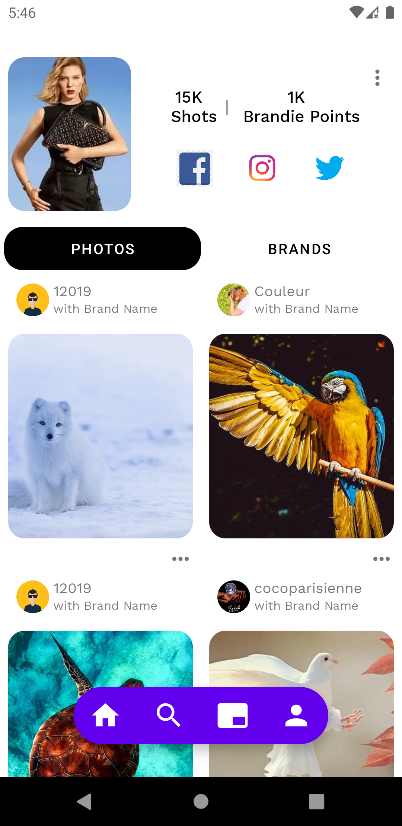
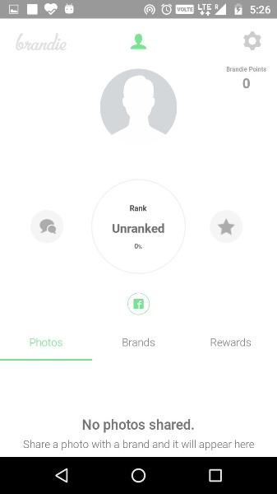
The Profile

Slide 12
Coding Time – The backend
MVVM
Data binding
Architecture components
Material Design
LeakCanary
Enforced coding Style
Image Cache
Error Handling
Unit Testing

Slide 13
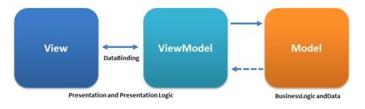
The MVVM

Slide 14
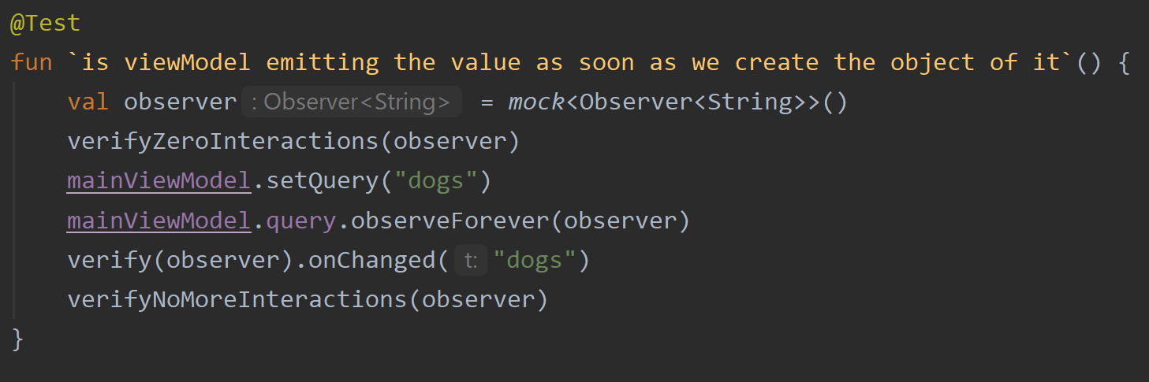
Unit Testing

Slide 15
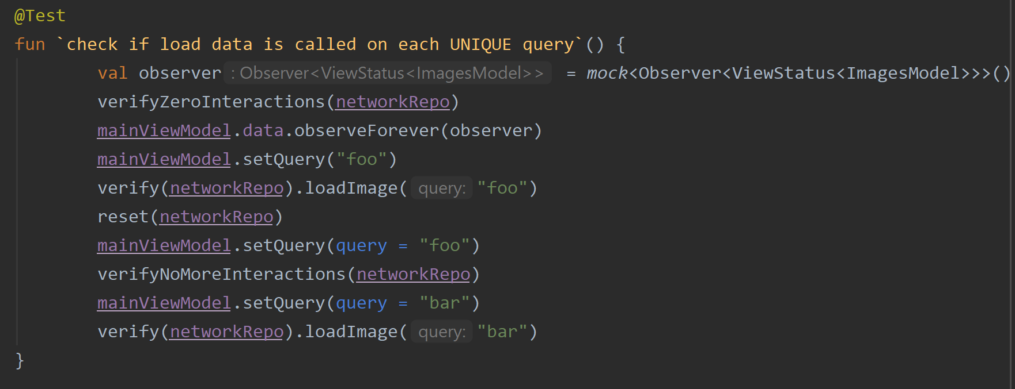
Unit Testing

Slide 16
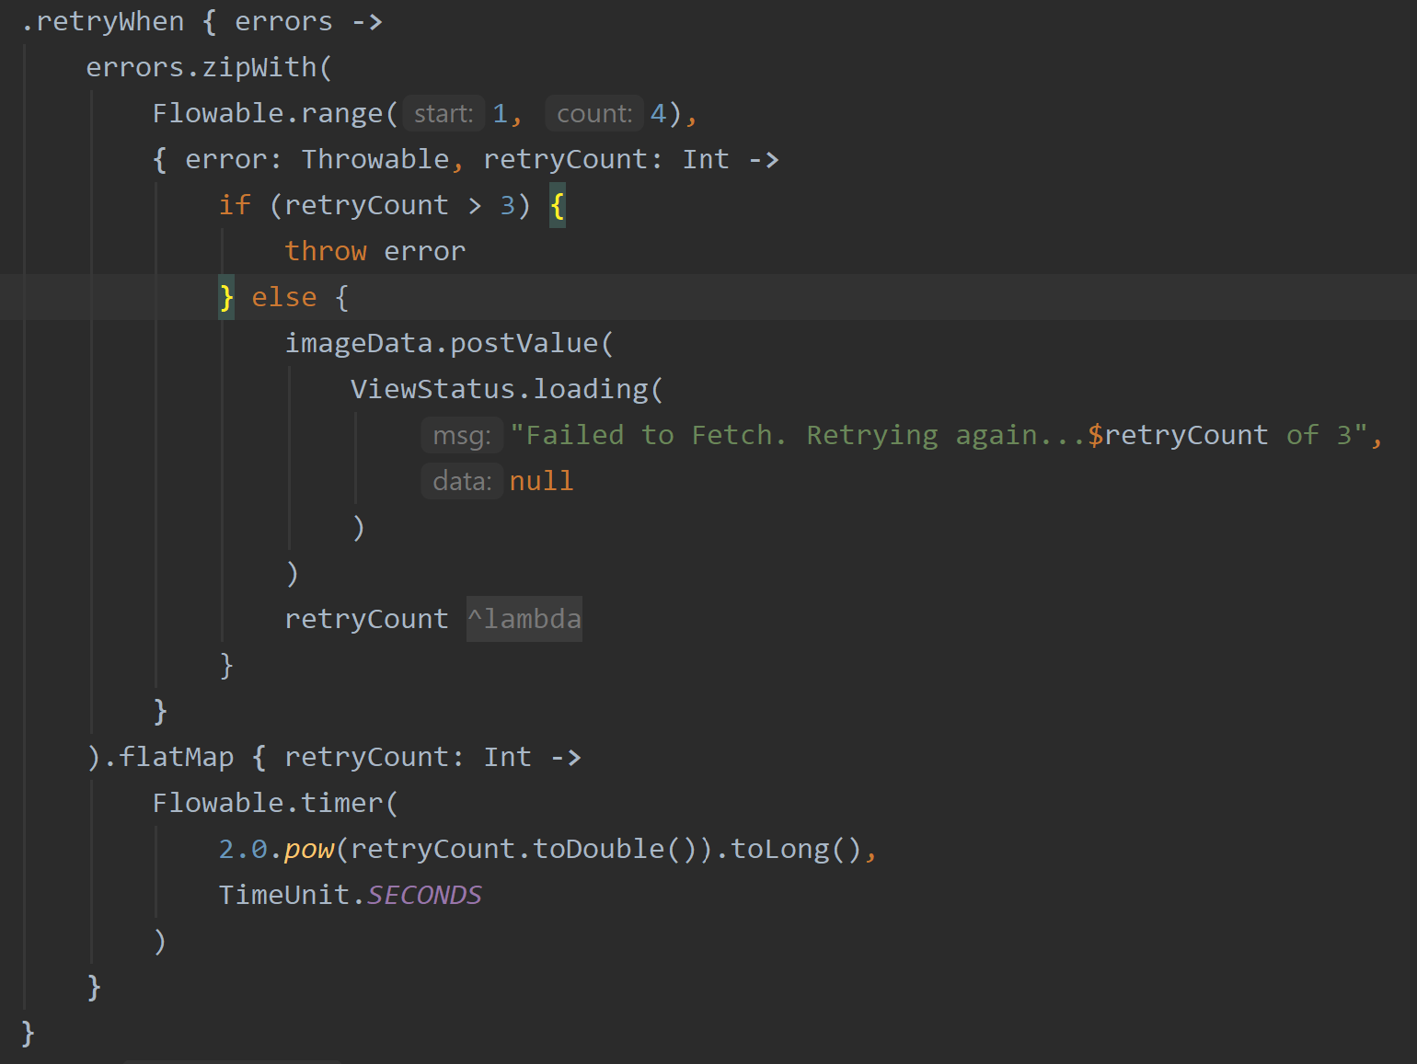
Error Handling

Slide 17
References
1. MVVM: https://www.google.com/url?sa=i&url=https%3A%2F%2Fen.wikipedia.org%2Fwiki%2FModel%25E2%2580%2593view%25E2%2580%2593viewmodel&psig=AOvVaw2FsvV473yj1ONdFN4cLOW1&ust=1600950635259000&source=images&cd=vfe&ved=0CAIQjRxqFwoTCND2jIKk_-sCFQAAAAAdAAAAABAD
2. Illustration: https://kit8.net/images/thumbnails/580/435/detailed/3/Man_computer@2x.png
3 Thumb Rule: https://miro.medium.com/max/6600/1*QmKvoNyyFSQ4LB3azrAnGQ.png

